Slide 1
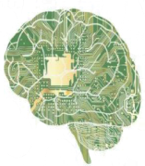
Introduction to Deep Learning and PyTorch
Artificial Intelligence and Machine Learning Club - AIMLC

Slide 2
Content
What is Deep Learning? (and why???)
Nuts and Bolts of Neural Networks
neurons
activations
layers
loss function
backpropagation
gradient descent
Intro to PyTorch
...
ConvNets and RecurrentNets

Slide 3
What is Deep Learning ?
“Its about learning complex concepts from simpler ones” – Ian Good fellow

Slide 4
It is the “HOLY GRAIL” of A.I.
Google, Microsoft and other big giants are all investing huge money in deep learning.
Artificial intelligence is the new electricity – Andrew NG
Deep Learning Market worth 1,722.9 Million USD by 2022 – marketsandmarkets.com

Slide 5
What are its applications ?
INFINITE

Slide 6

Image Classification
Course : CS231n

Slide 7
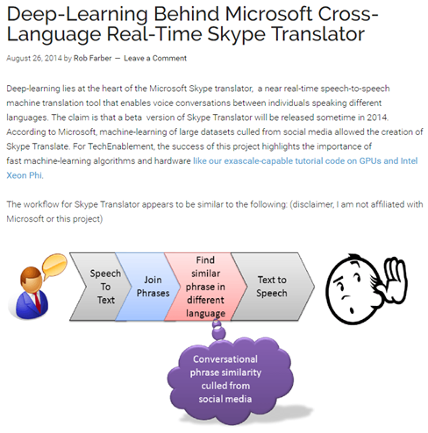
Natural Language Processing
Course : CS224d - Deep Learning for
Natural language Processing

Slide 8
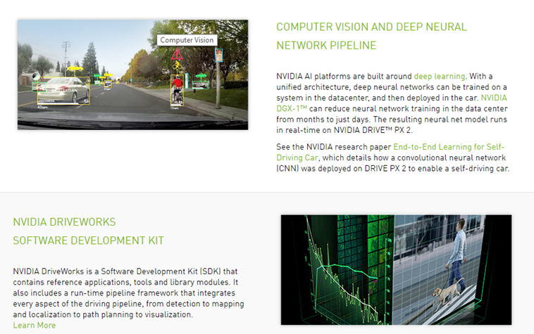
Self Driving
Course: 6.S094 - Deep Learning for Self-Driving Cars

Slide 9
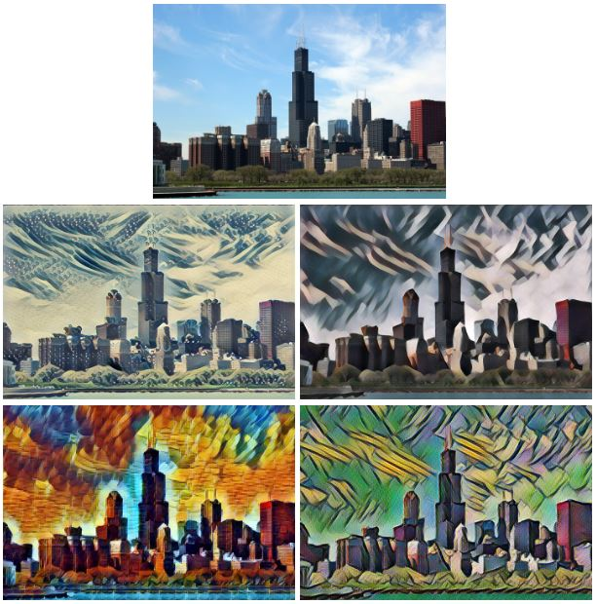
Some more….
Deep Learning Models can also,
Paint.

Slide 10
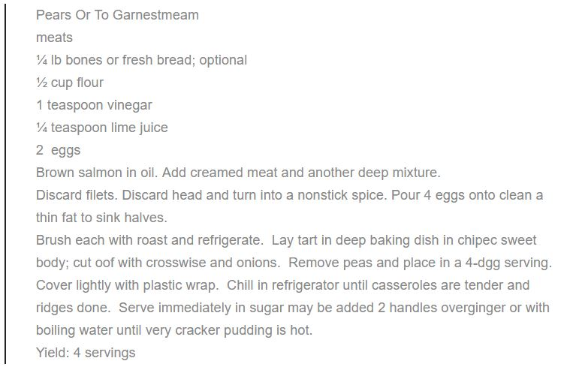
Some more….
Deep Learning Models can also,
Make Recipes.

Slide 11
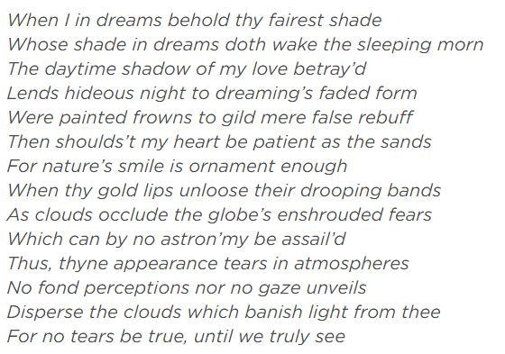
Some more….
Deep Learning Models can also,
Do Poetry.

Slide 12

Some more….
Deep Learning Models can also,
Make Music.
Source : http://www.hexahedria.com/2015/08/03/composing-music-with-recurrent-neural-networks/

Slide 13
Why Deep Learning and Why Now?

Slide 14
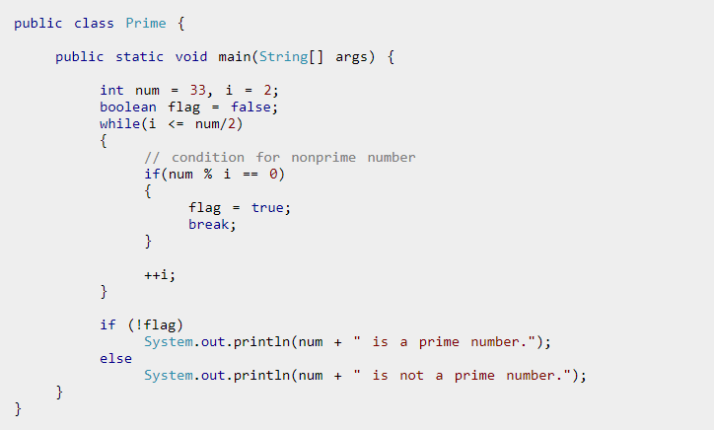
Standard program for checking if a number is prime

Slide 15
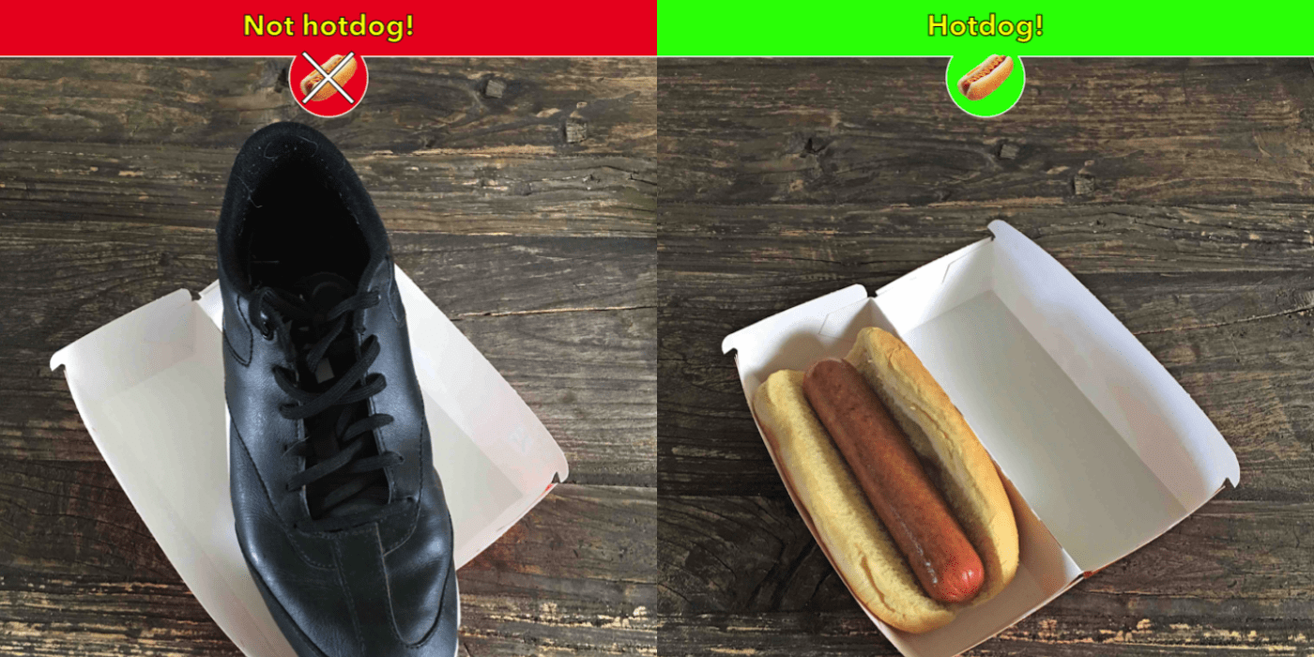
But how to write

Slide 16
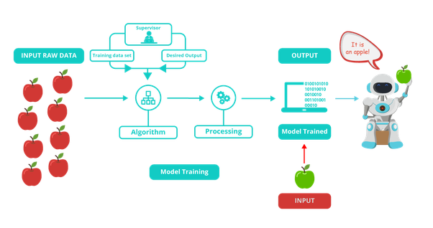
Enter Deep Learning (actually machine learning)

Slide 17
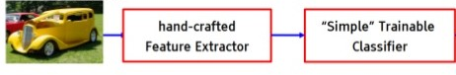
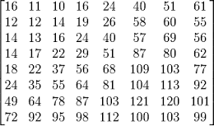
Why Deep Learning?

Slide 18
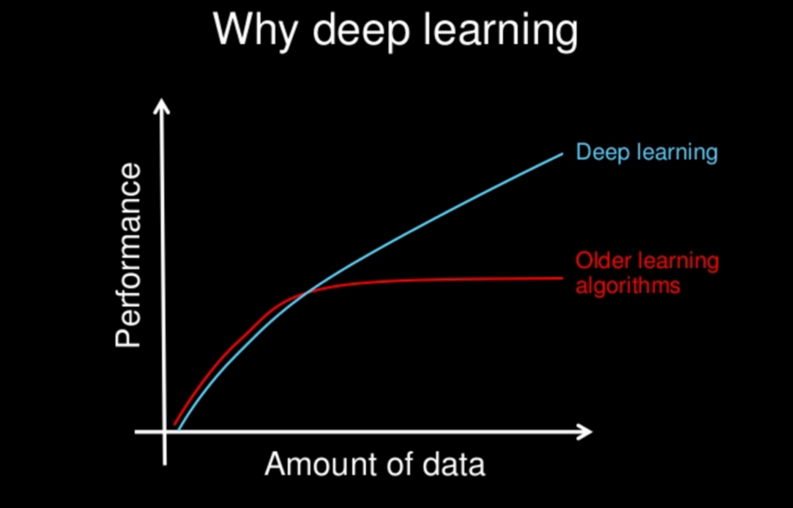
and…

Slide 19
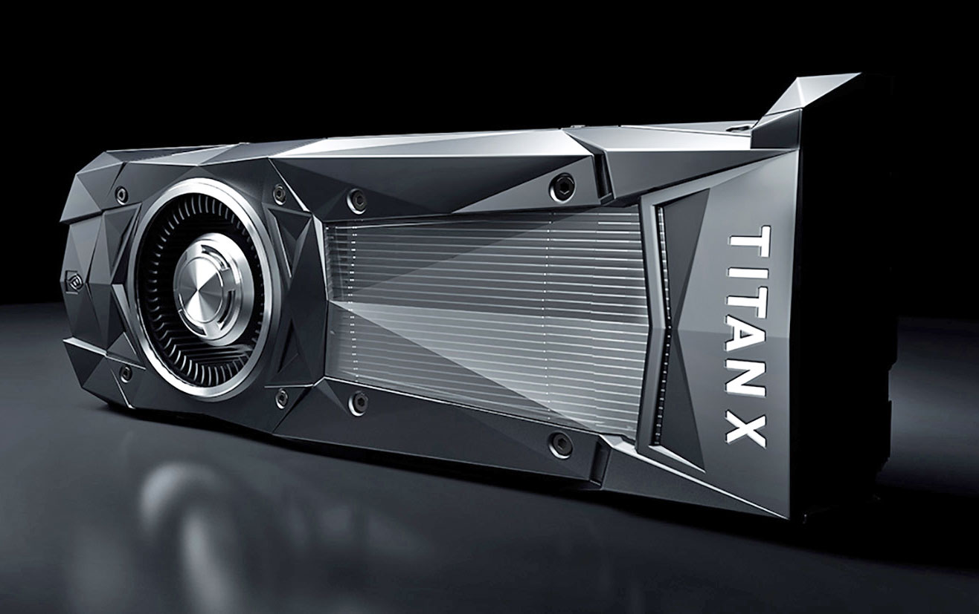

Why now?
More data.
Better/cheaper computing devices (GPUs mainly).

Slide 20
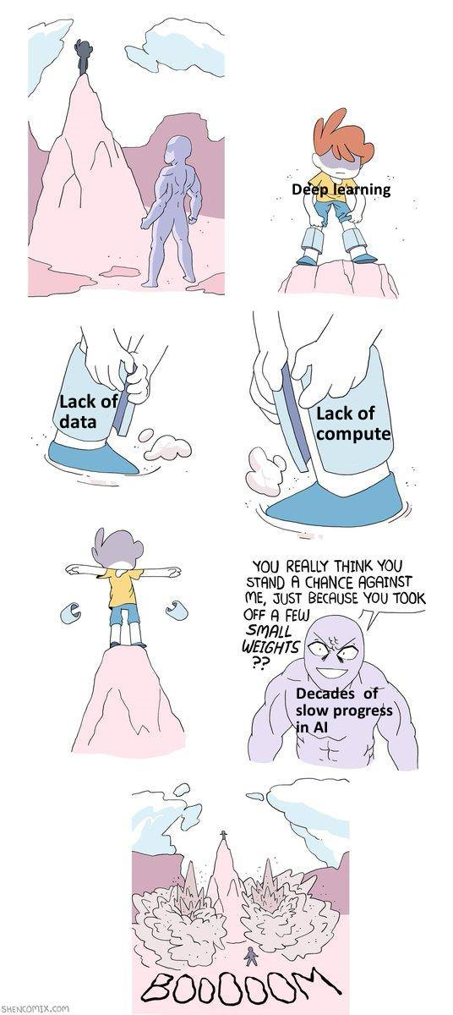

Slide 21
What is learning?
“Learning is any process by which a system improves performance by experience” - Herbert Alexander Simon
Types of Learning -Supervised -Unsupervised

Slide 22
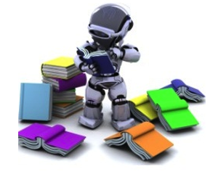
Supervised Learning
Training data includes both the input and desired output/result.
Data = {(x⁽¹⁾, y⁽¹⁾), (x⁽²⁾, y⁽²⁾), … ,(x^{(m)}, y^{(m)})}
Target
Error
Supervised Learning
Input
Output

Slide 23
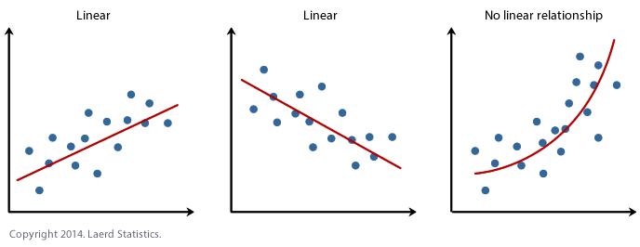
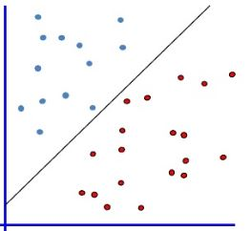
Supervised Learning
Regression Classification

Slide 24
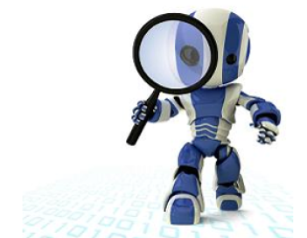
Unsupervised Learning
Training data does not include desired output/result.
Data = {(x⁽¹⁾), (x⁽²⁾), … ,(x^{(m)})}
Unsupervised Learning
Input
Output

Slide 25
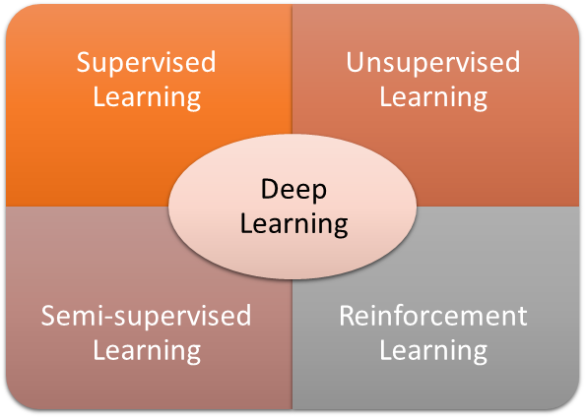

Slide 26
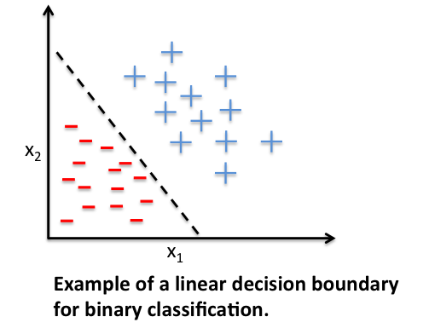
Linear Predictors
In statistics and in machine learning, a linear predictor function is a linear function of a set of coefficients(weights) and explanatory variables(features), whose value is used to predict the outcome of a dependent variable(class label).

Slide 27
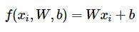
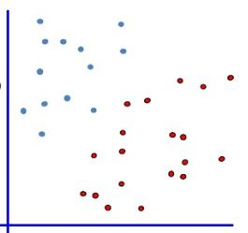
i.e.
A linear mapping from x^{(i)} to class labels.
where x = ( x₁, x₂, … , x_{n} )
W = ( w₁, w₂, … , w_{n} )

Slide 28
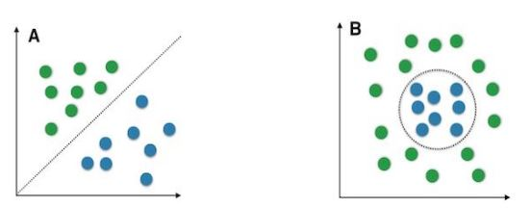
But…
Most of the real world data is not linearly separable.

Slide 29
Nuts and Bolts of Neural Networks

Slide 30
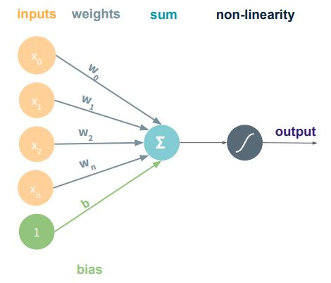
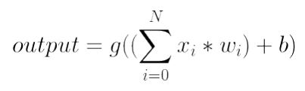
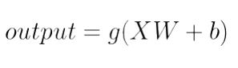
Artificial Neurons

Slide 31
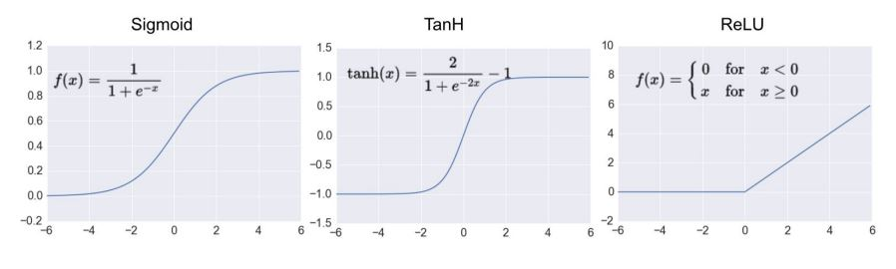
Activation Functions

Slide 32
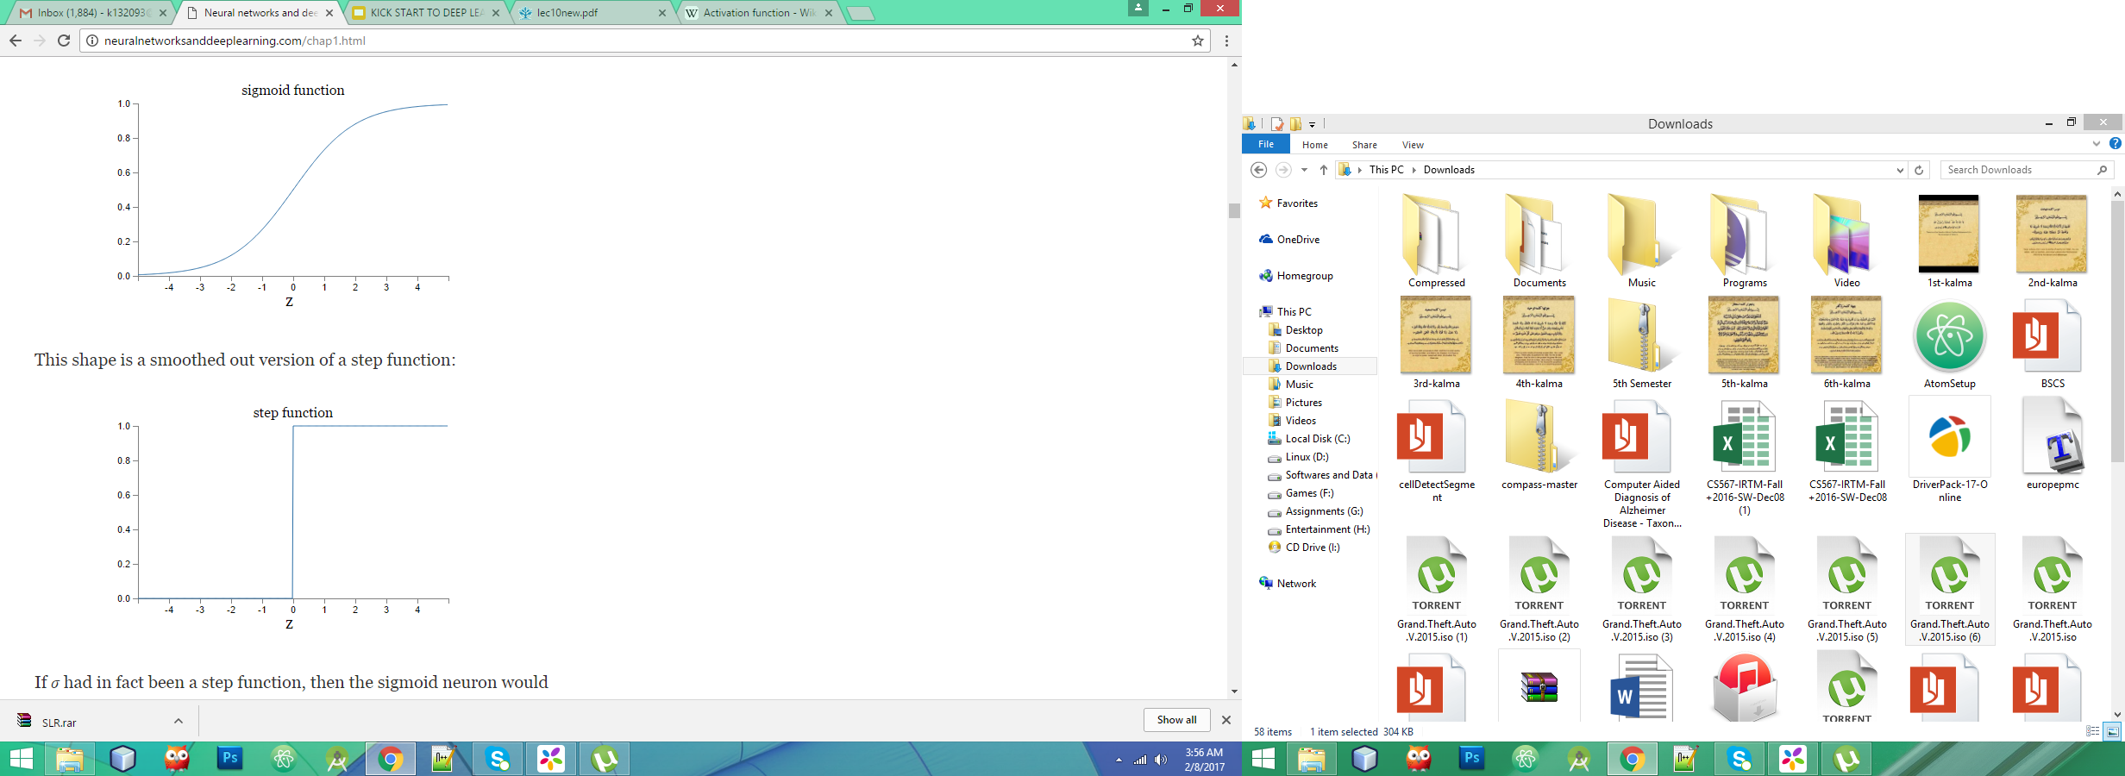
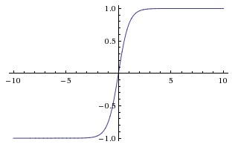
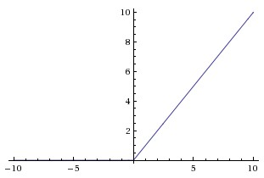
Activation Functions
Sigmoid: Gradients Saturate quickly
Tanh: Zero-centered and thus preferred over sigmoid
Relu: shows faster convergence, simpler,
and avoids the problem of vanishing gradients.

Slide 33
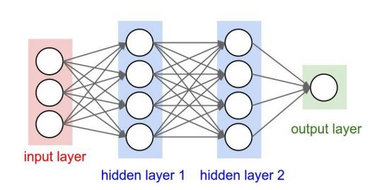
Neural Network

Slide 34
Neural Network Components
Input Layer
Hidden Layer
Output Layer
Loss Function

Slide 35
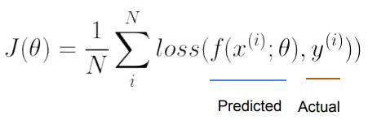
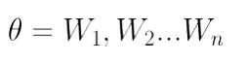
So how does it learn?
Loss function A loss function Loss(x, y, w) quantifies how unhappy you would be if you used (current)w to make a prediction on x when the correct output is y.
Credit: MIT 6.S191

Slide 36
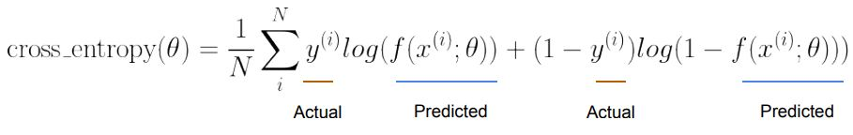
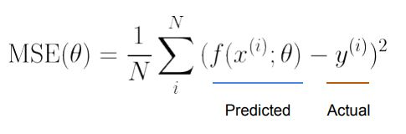

Slide 37
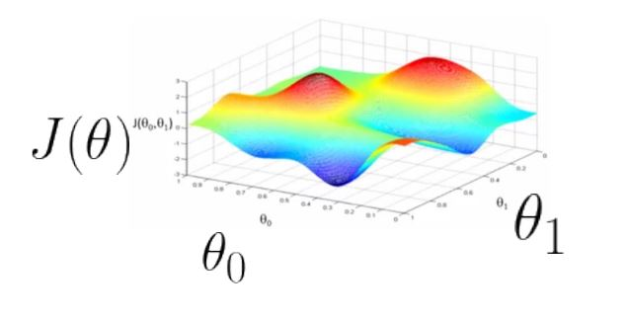
Loss is function of parameters (theta) :
Source: Machine Learning – Ng (Coursera)

Slide 38
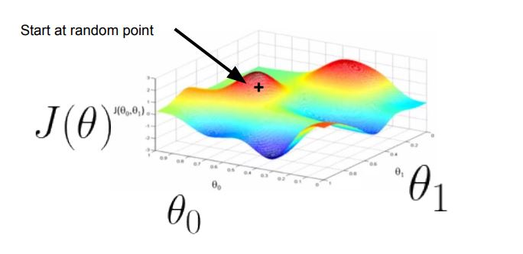
Gradient Descent

Slide 39
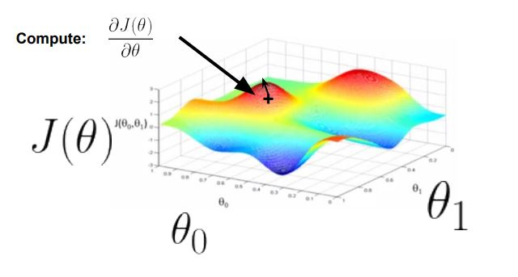
Gradient Descent

Slide 40
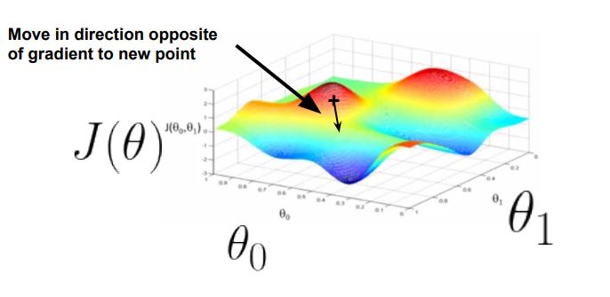
Gradient Descent

Slide 41
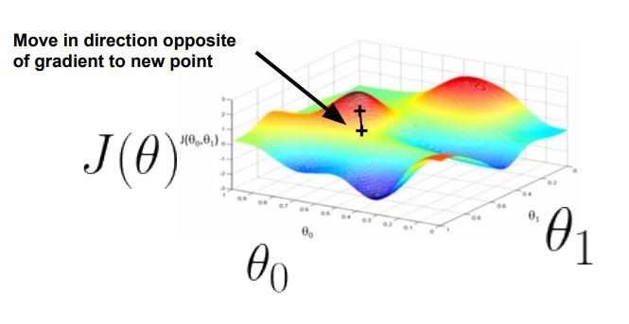
Gradient Descent

Slide 42
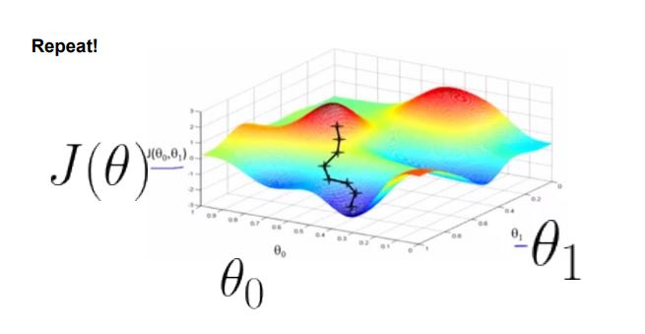
Gradient Descent

Slide 43
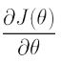
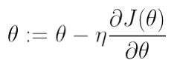
Stochastic Gradient Descent (SGD) :
Repeat {
1. Calculate class label for X^{(i)}
2. Calculate cost
3. Compute
4. Update parameters :
}

Slide 44
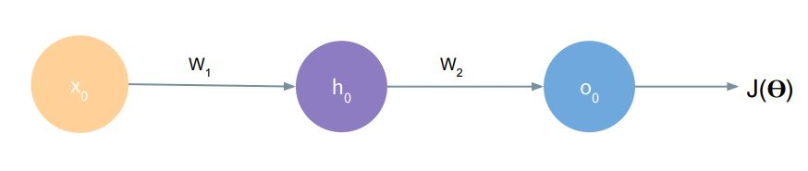
Back-Propagation
Credit: MIT 6.S191

Slide 45
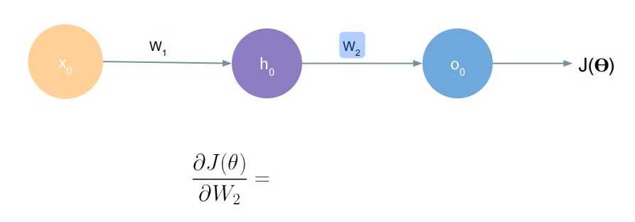
Back-Propagation
Credit: MIT 6.S191

Slide 46
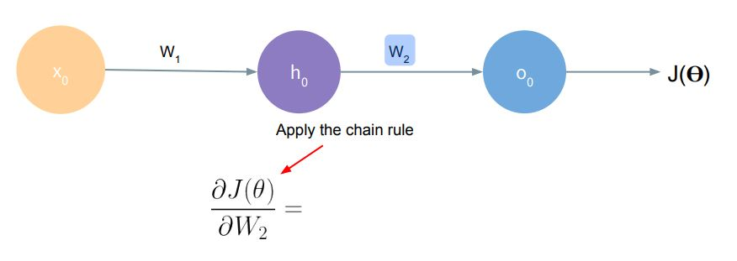
Back-Propagation
Credit: MIT 6.S191

Slide 47
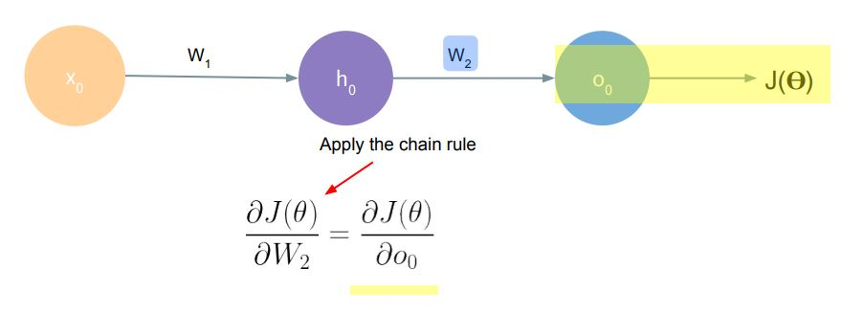
Back-Propagation
Credit: MIT 6.S191

Slide 48
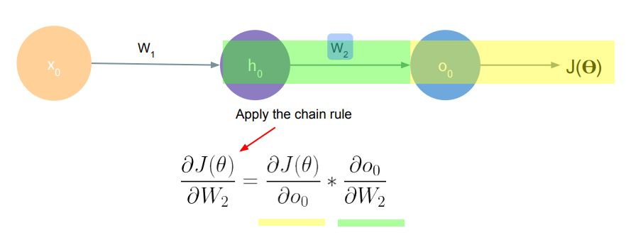
Back-Propagation
Credit: MIT 6.S191

Slide 49
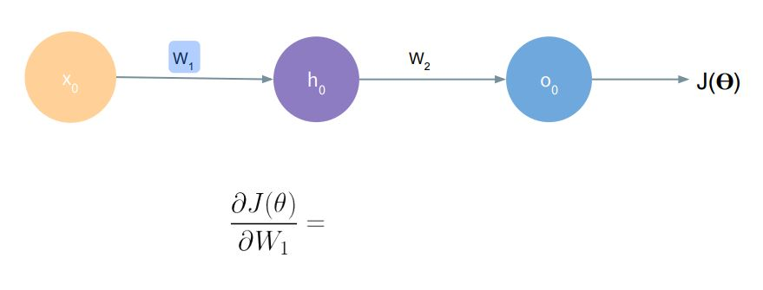
Back-Propagation
Credit: MIT 6.S191

Slide 50
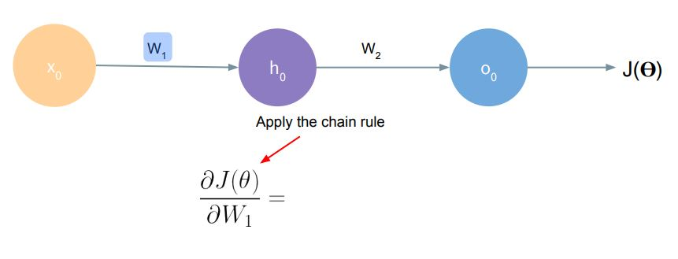
Back-Propagation
Credit: MIT 6.S191

Slide 51

Back-Propagation
Credit: MIT 6.S191

Slide 52

Back-Propagation
Credit: MIT 6.S191

Slide 53

Back-Propagation
Credit: MIT 6.S191

Slide 54

Choosing a learning rate
Too Big : Too Small :

Slide 55
Let’s Code!

Slide 56

Convolutional Neural Network

Slide 57


CNN Structure
$\left(\left(Conv, NonLinearity\right)\left(€+Pool\right)\right)∗$ (FC)

Slide 58

CONVOLUTION LAYER

Slide 59

CONVOLUTION LAYER

Slide 60

CONVOLUTION LAYER

Slide 61

CONVOLUTION LAYER

Slide 62

CONVOLUTION LAYER

Slide 63

CONVOLUTION LAYER

Slide 64

CONVNET ARCHITECTURE

Slide 65

Convolution Operation
Credit:CS231n

Slide 66

Convolution Operation
Credit:CS231n

Slide 67

Convolution Operation
Credit:CS231n

Slide 68

Convolution Operation
Credit:CS231n

Slide 69

Convolution Operation
Credit:CS231n

Slide 70

Convolution Operation
Credit:CS231n

Slide 71

Convolution Operation
Credit:CS231n

Slide 72

Convolution Operation
Credit:CS231n

Slide 73

Convolution Operation
Credit:CS231n

Slide 74

Pooling in Action
CS 678 – Deep Learning
Notes:
L2 pooling – Square root of sum of the activation squares in the field – ~average magnitude
Max pooling – winner take all for receptive field
Small fields most common (2x2), also allows for deeper network
Note depth of network is basically decided by the sub sampling pool size, since once the feature maps are small (e.g. 5x5) there no more room for convoluting and need to just put then in the MLP
Can get some effects of Pooling and save computation by having convolutional layers less tightly overlapped (stride)

Slide 75

CNN Learning
Credit: MIT 6.S191

Slide 76
Summary
CNNs stack Conv, Pool, FC layers.
Trends towards smaller filters and deeper architectures.

Slide 77

Sequence Modeling with Neural Networks

Slide 78


What is a sequence?
“I took the dog for a walk this morning.”
●
sentence
function
●
speech waveform
Credit: MIT 6.S191

Slide 79



Successes of deep models
Machine translation
Question Answering
Left:
https://research.googleblog.com/2016/09/a-
neural-network-for-machine.html
Right:
https://rajpurkar.github.io/SQuAD-explorer/

Slide 80
how do we model sequences?

Slide 81

Application: Character-Level Text Generation
Life Is About The Weather!
Life Is About The True Love Of Mr. Mom Life Is About Kids
Life Is About An Eating Story Life Is About The Truth Now
The meaning of life is literary recognition
The meaning of life is
the tradition of the ancient human reproduction
Andrej Karpathy. “The Unreasonable Effectiveness of Recurrent Neural Networks." (2015).

Slide 82
Problem : Given a sentence translate it to another language.

Slide 83
Problem : Given a sentence translate it to another language.
“a sentence is nothing but sequence of words”

Slide 84
Let’s turn to recurrent neural networks! (RNNs)
to maintain word order
to share parameters across the sequence
to keep track of long-term dependencies

Slide 85


Slide 86




Application: Handwriting Generation from Text
Input:
Output:
Alex Graves. "Generating sequences with recurrent neural networks." (2013).
Source: MIT 6.S094

Slide 87
Pitfalls
Needs a lot of data!
Same for Compute!!
Unexplainable!!!
“Deep Learning works very well in problems where there is a repetitive structure in space or time” – Prof. Josh Tenenbaum

Slide 88


Slide 89
Q/A

